Slide 1
IE 403/476 Human-Computer Interaction
Week 9-Lec 1

Slide 2
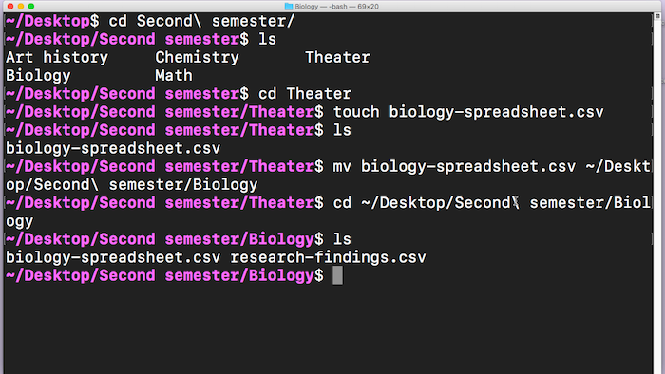
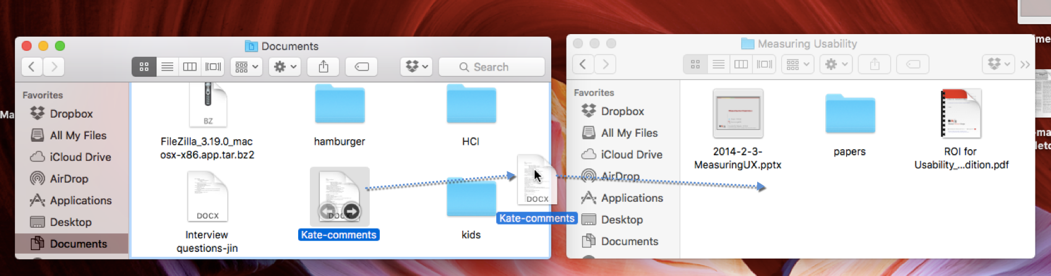
Moving File: CLI Vs Dragging

Slide 3
Direct Manipulation Interfaces
A direct manipulation interface allows a user to directly act on a set of objects in the interface.

Slide 4
Pros of DMI
While interacting with DM interfaces, users feel as if they are
interacting with the domain
rather than with the interface,
Focus on the task rather than on the technology.
Direct involvement with a world of task objects rather than communication with an intermediary.
No more Clear distinction between I/P and O/P
Document icon as input by user but represents an output state of a file/application

Slide 5
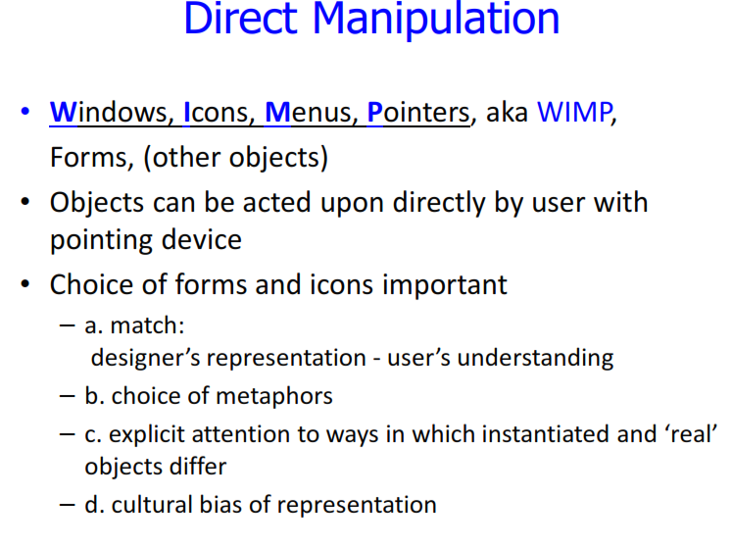

Slide 6
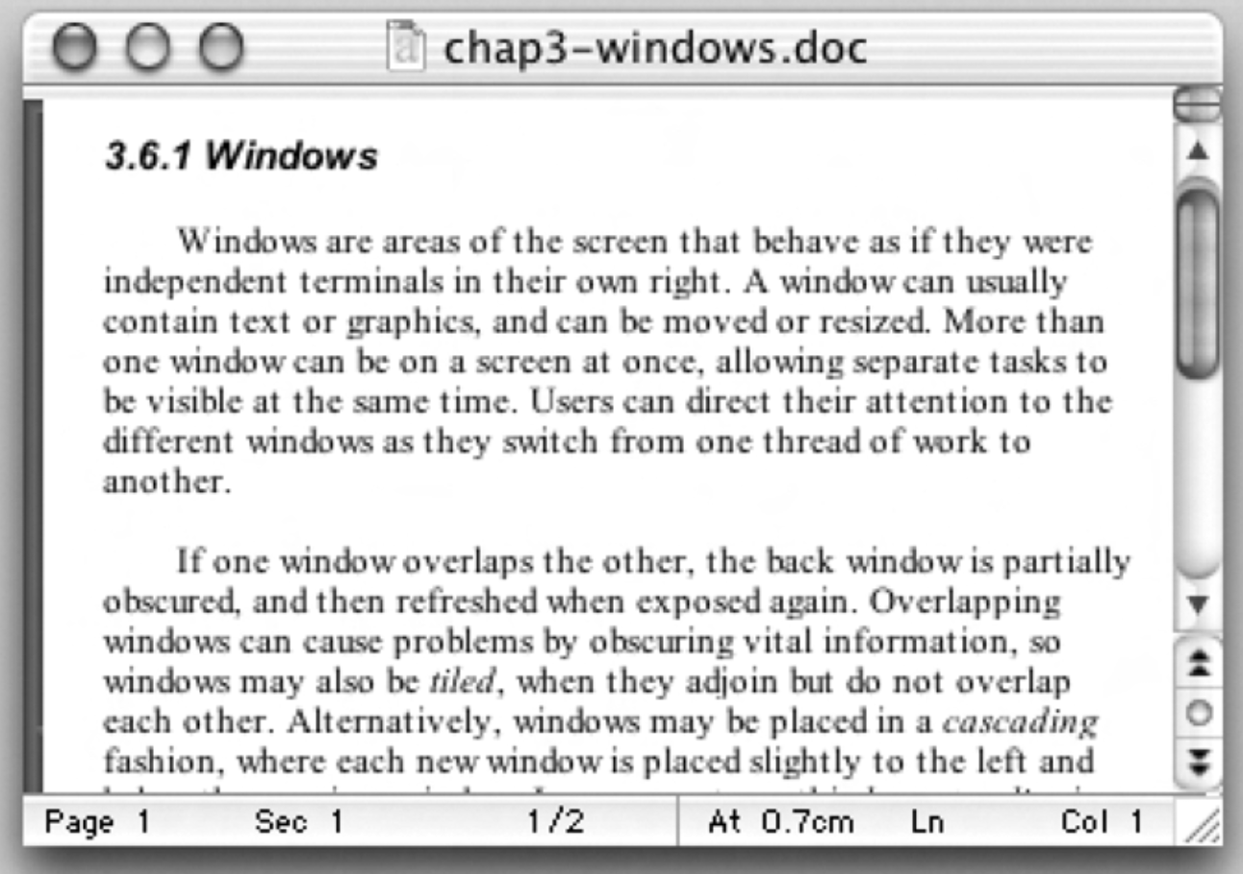

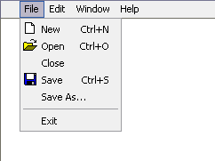
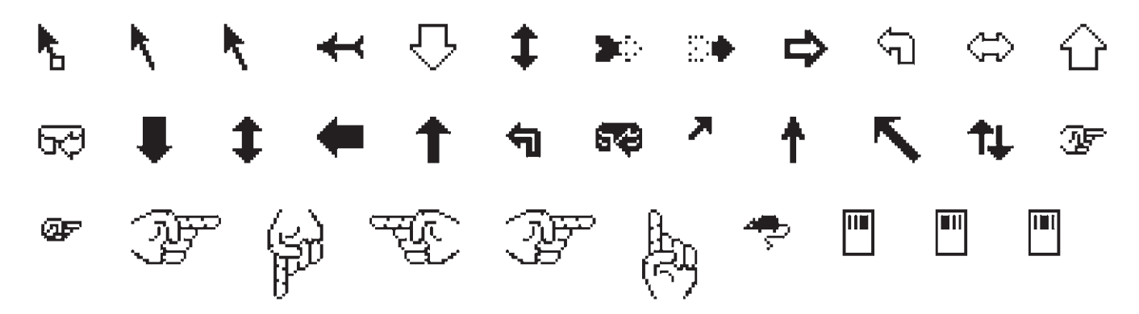
WIMP Interface
Windows
Icons
Pointers
Menus

Slide 7
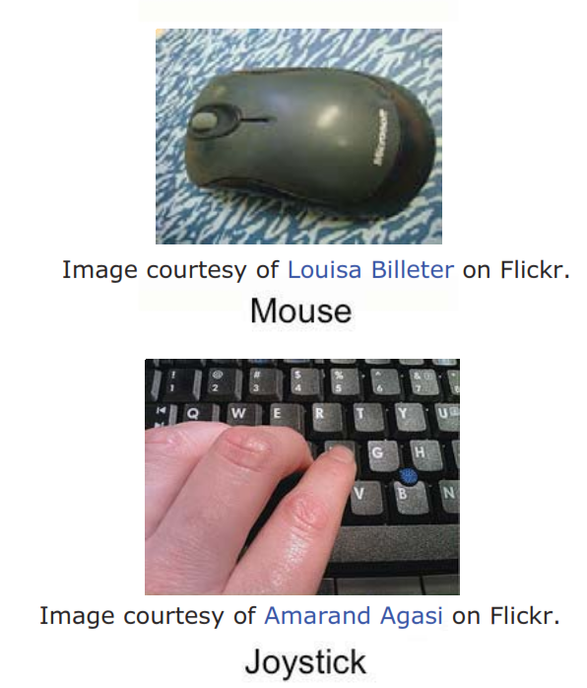
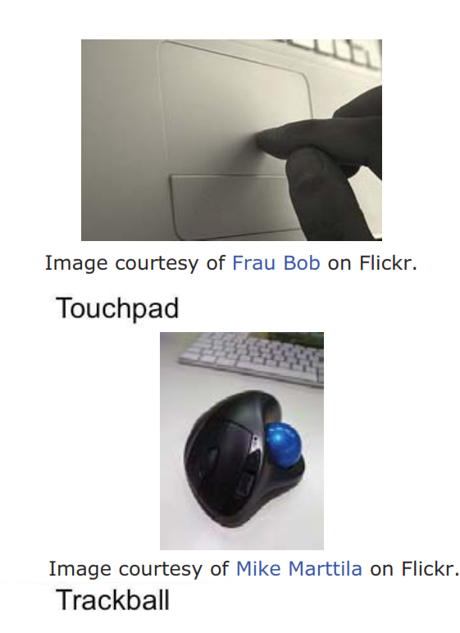
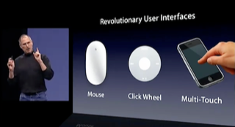
Pointing Devices
Mouse = Indirect pointing
Stylus/finger = direct pointing

Slide 8
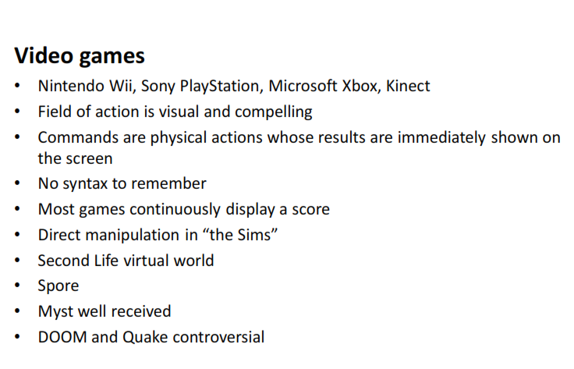

Slide 9
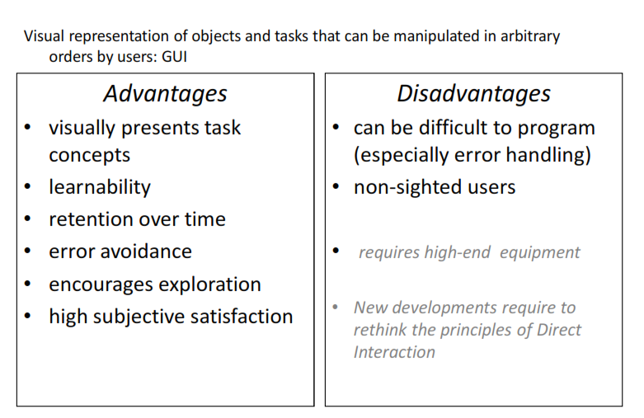

Slide 10

More Disadvantages: DM not always good
Rearranging movies in a queue: Typing or dragging nth movie to mth position?

Slide 11
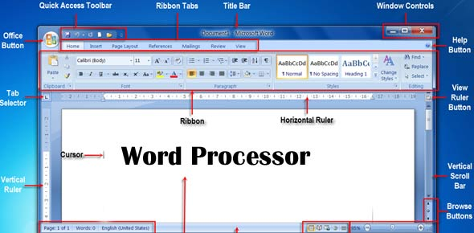
WYSIWYG – Word Processor

Slide 12
Ben Shneiderman’s Principles for DM
Visibility of the objects of interest
Incremental action at the interface with rapid feedback on all actions
Reversibility of all actions, so that users are encouraged to explore without severe penalties
Syntactic correctness of all actions, so that every user action is a legal operation
Replacement of complex command languages with actions to manipulate directly the visible objects (and, hence, the name direct manipulation).

Slide 13
Does Word processor satisfy Shneiderman’s criteria?
TextBook material

Slide 14
Shneiderman’s 8 Golden Rules
1. Strive for consistency
2. Cater to Universal Usability (Enable frequent users to use shortcuts)
3. Offer informative feedback
4. Design dialogs to yield closure
5. Offer error prevention and simple error handling
6. Permit easy reversal of actions
7. Support internal locus of control
8. Reduce short-term memory load

Slide 15
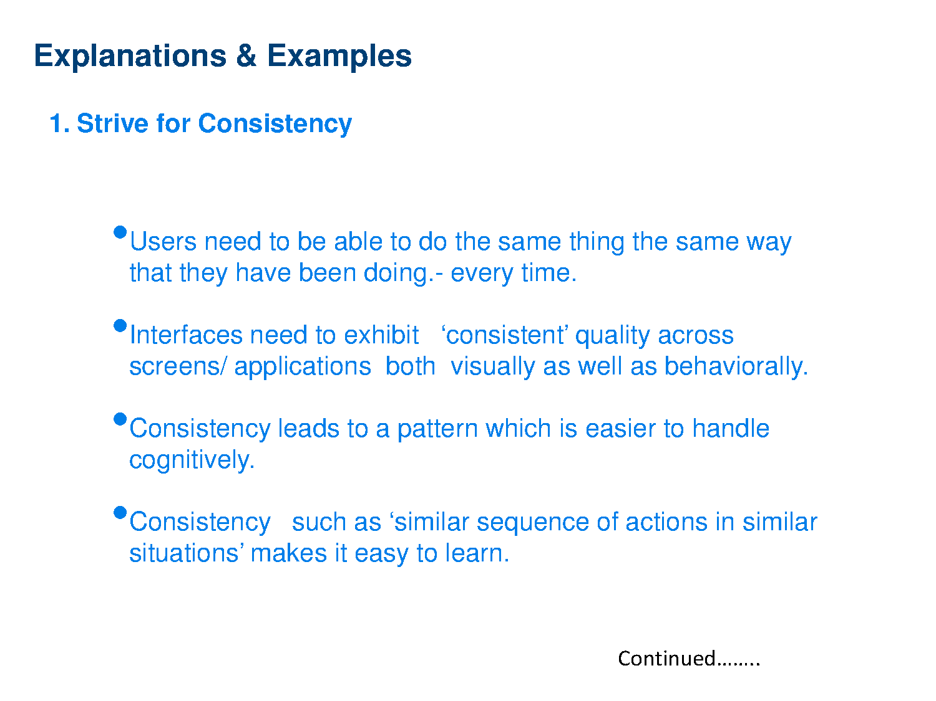

Slide 16
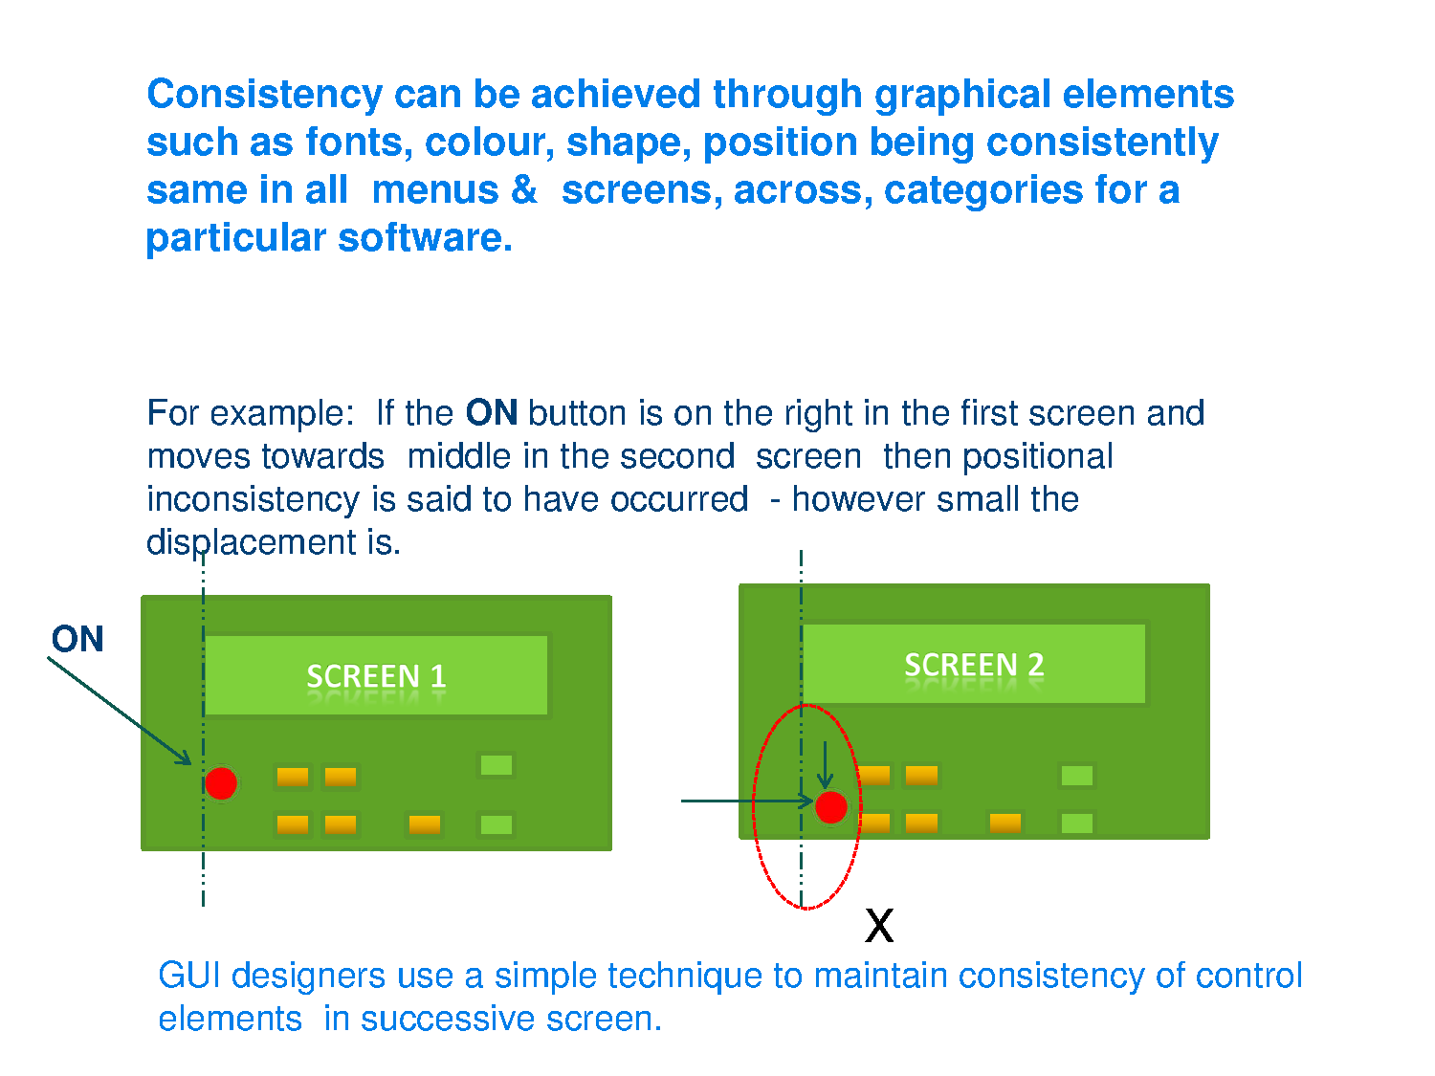

Slide 17
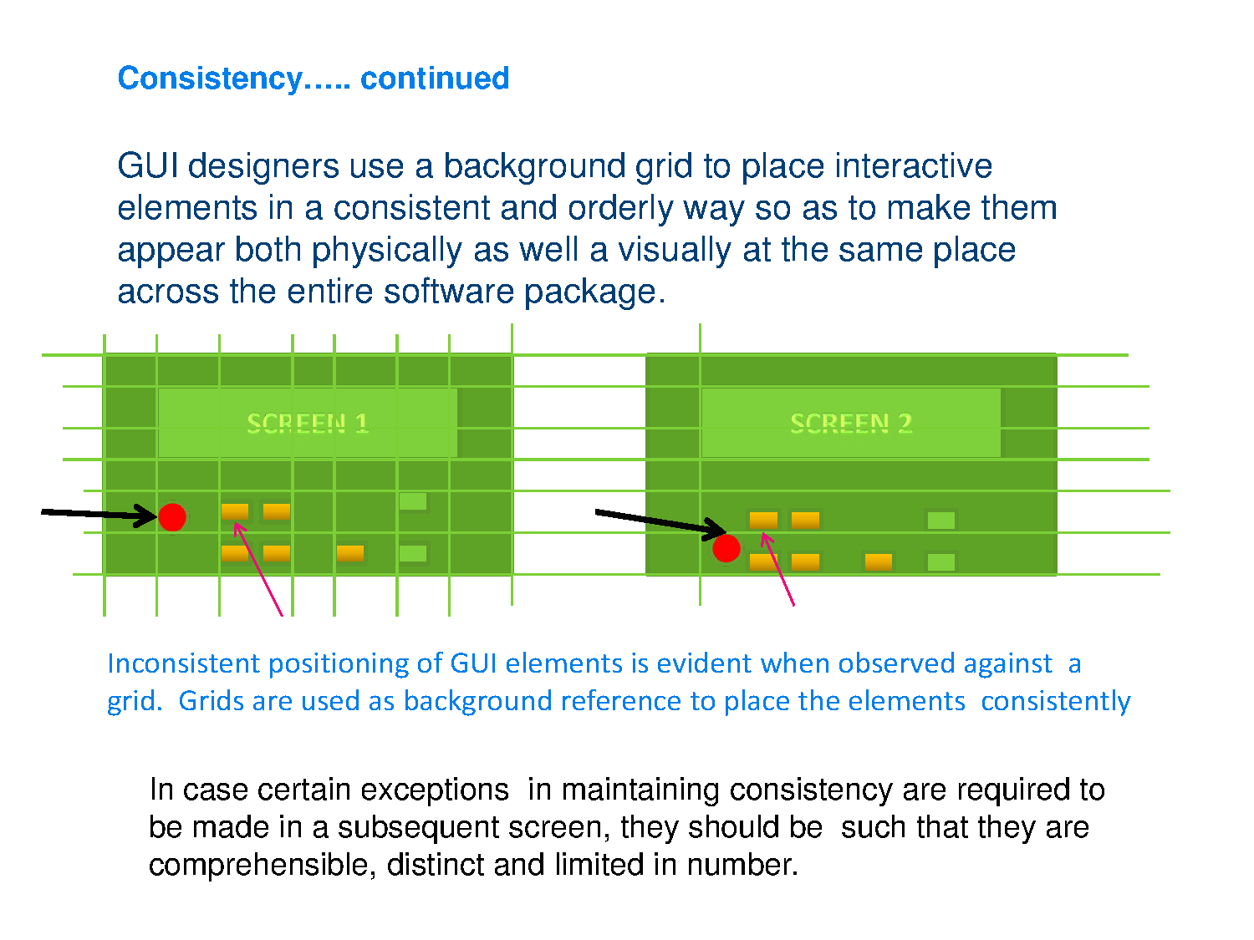

Slide 18
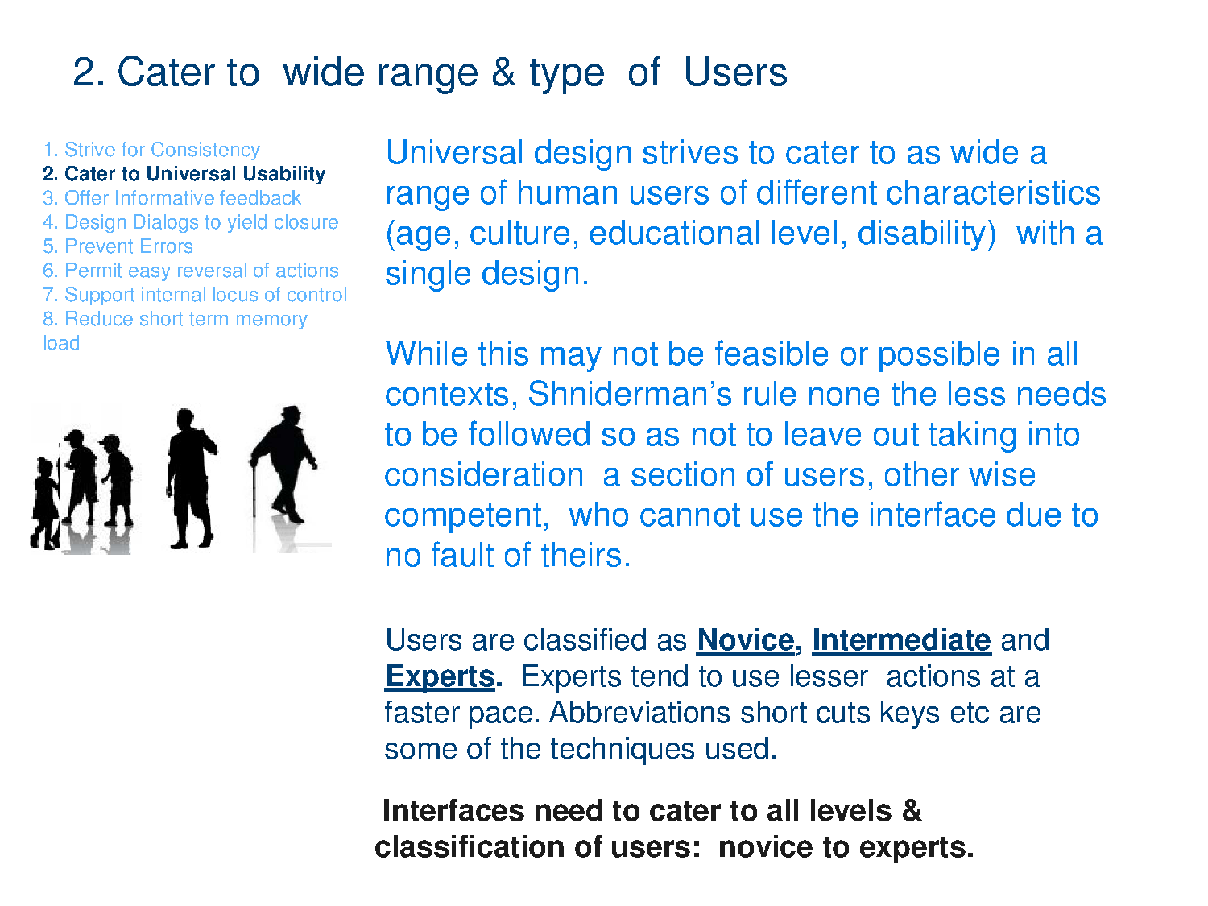

Slide 19
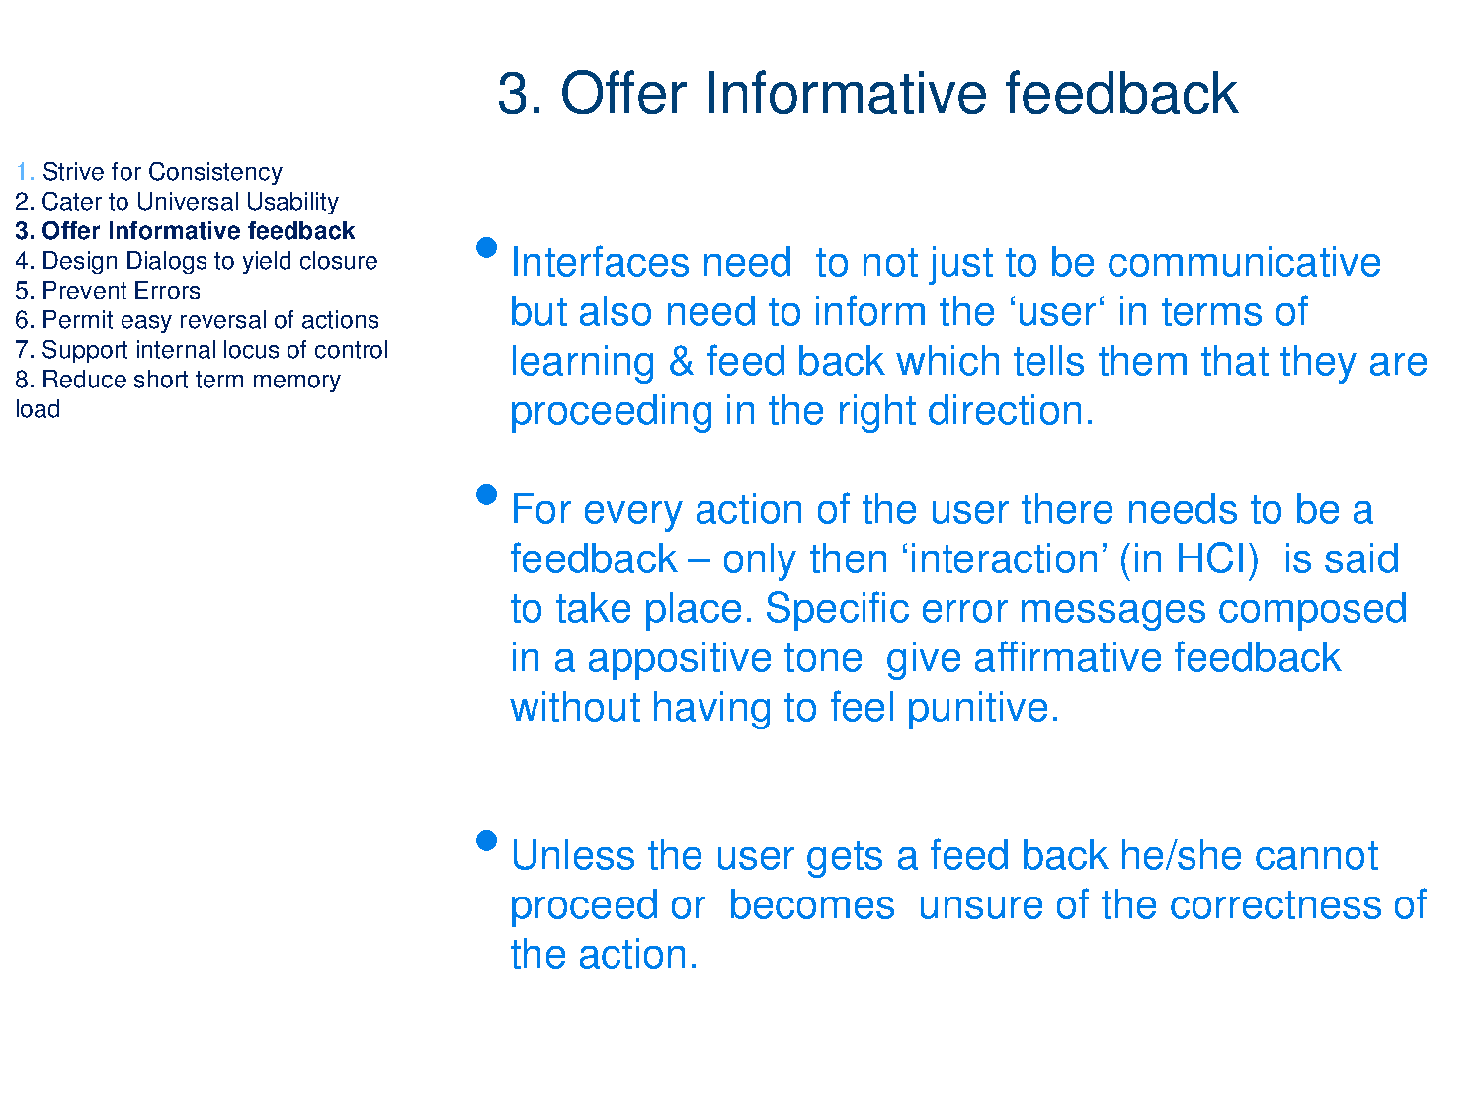

Slide 20
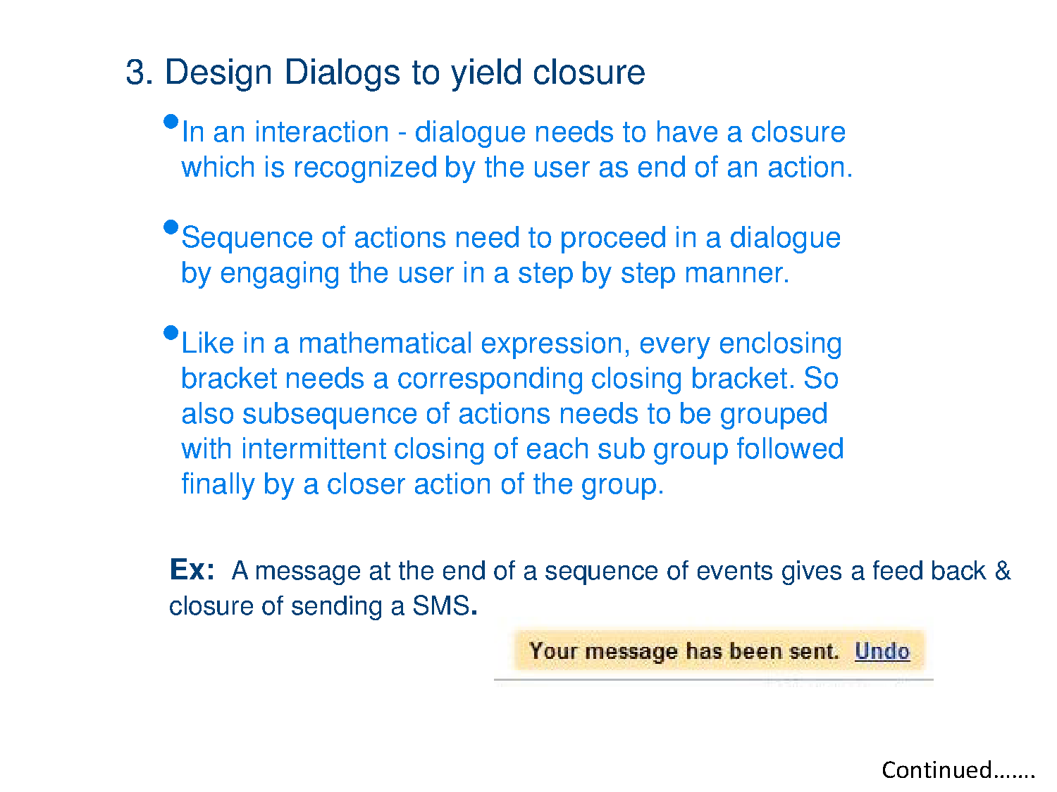
4.

Slide 21
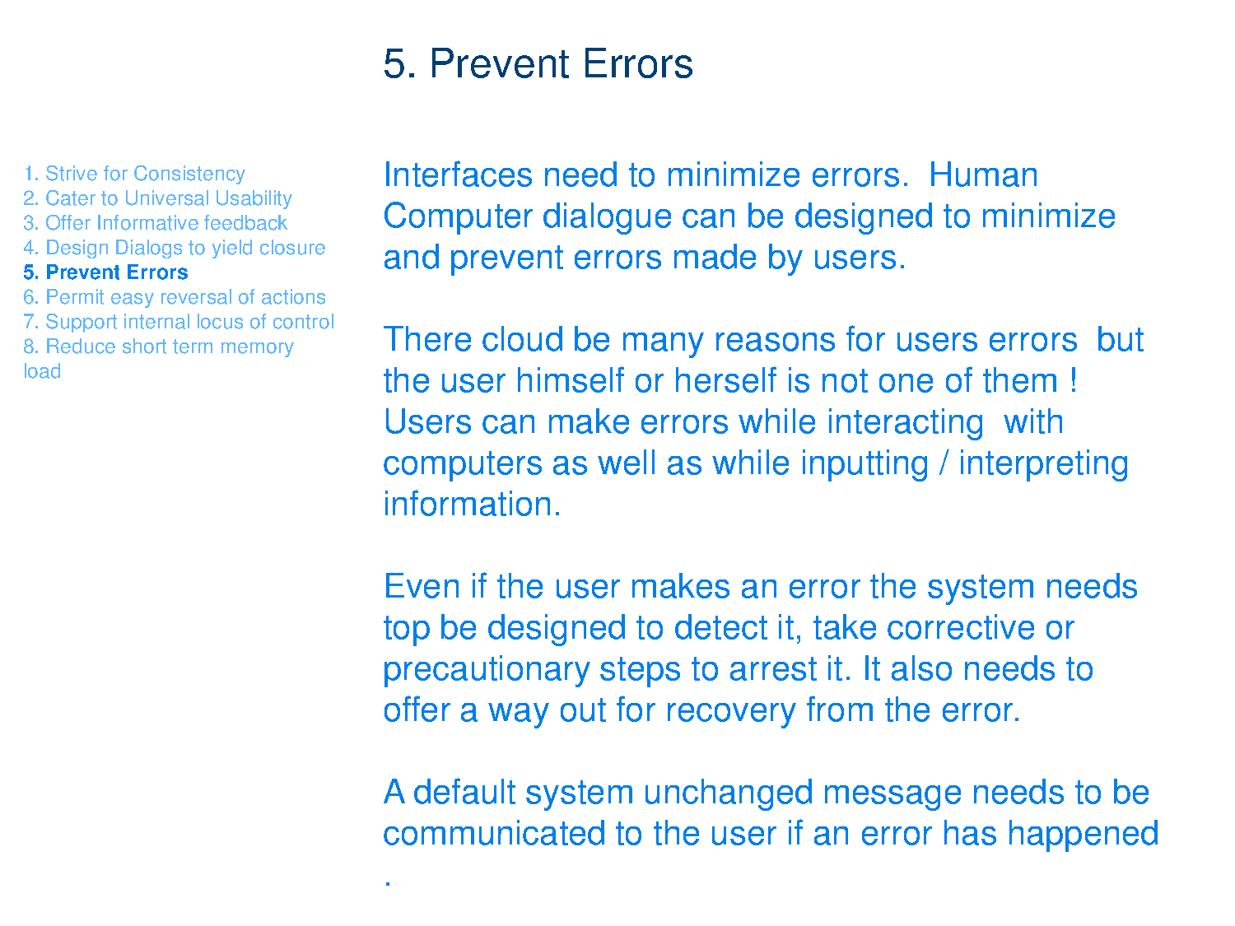

Slide 22
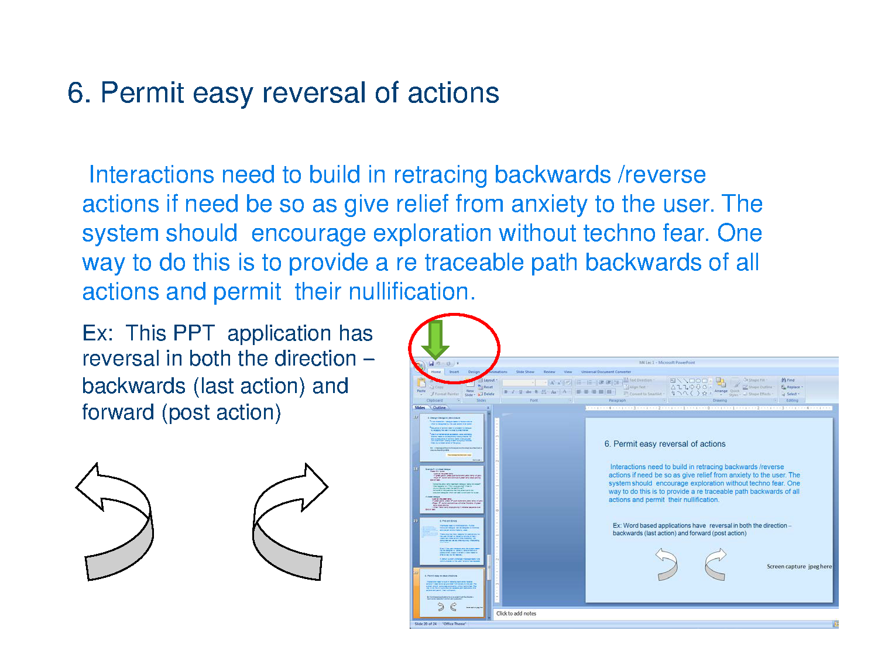

Slide 23
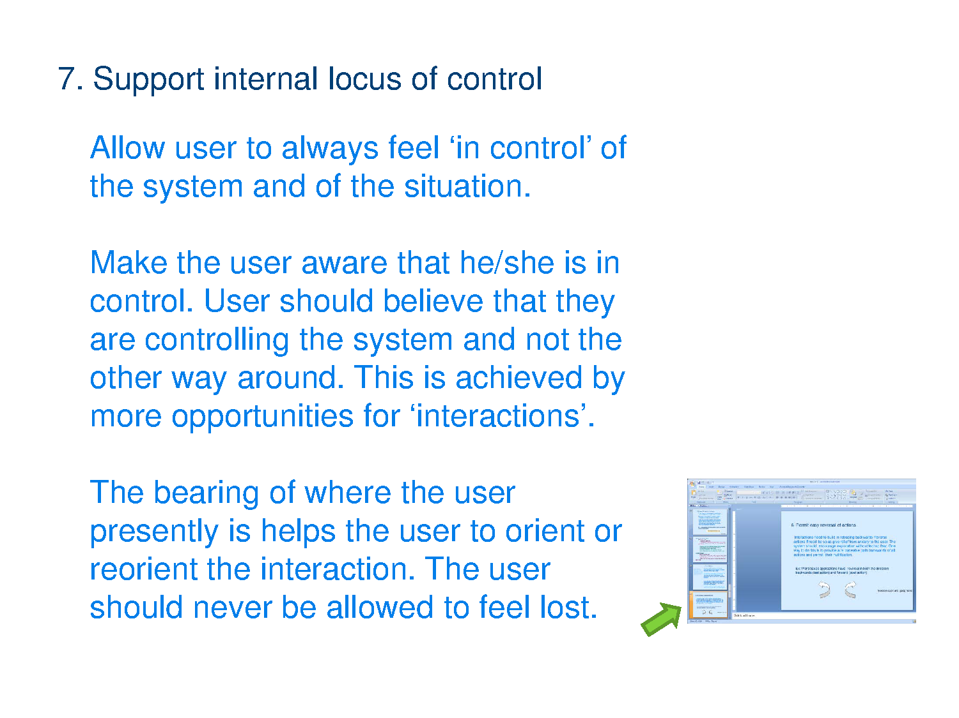

Slide 24
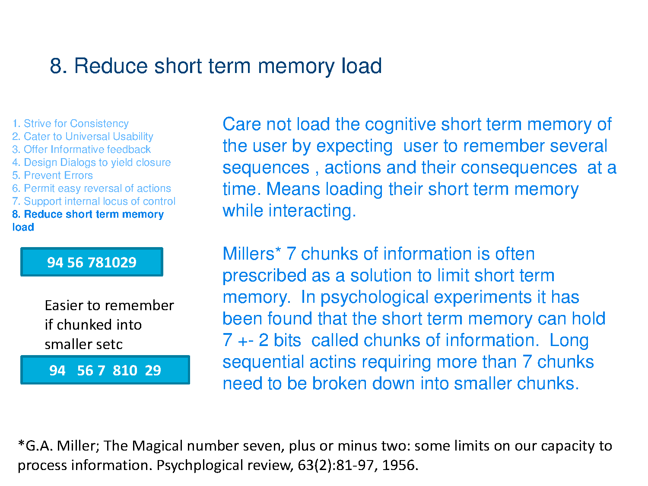

Slide 25
Conclusion
GUI – based on DM
Innovations in DM
Augmented Reality
Virtual Reality
Brain Machine Interfacing

